Slide 1
San Marcos Fire Department
March 21, 2024
TFCA Annual Conference
Budgeting and Finance Class

Slide 2
Budget Basics

Slide 3
Why Budget?
It’s the Law
Hearings and Notices
Inspection/Audit
Authorized by Ordinance
Structurally Balanced

Slide 4
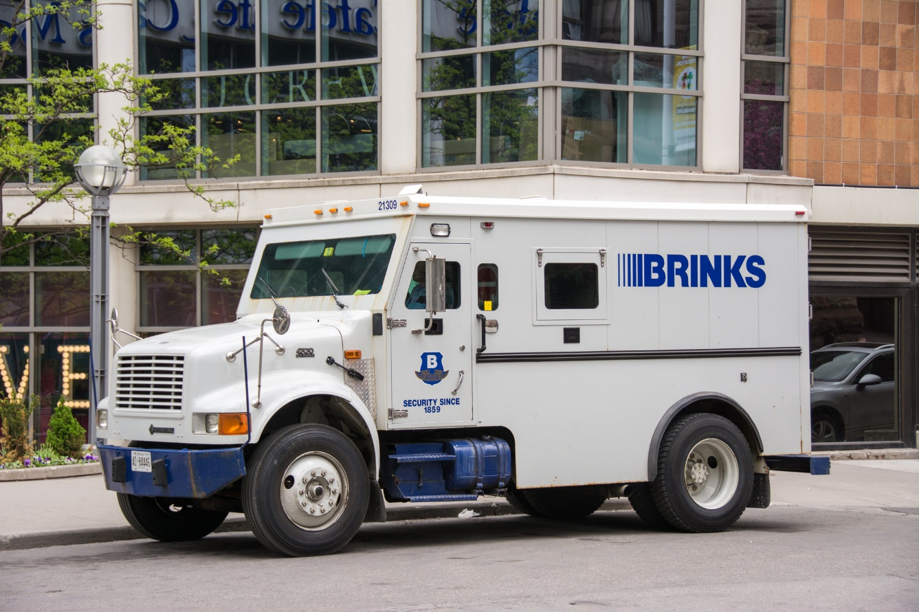
Revenues
Where does the money come from?

Slide 5
Forms of Revenue (General Fund)
Ad Valorem
Sales Tax
Franchise Fees/Utility Transfers
Fines and Forfeitures
Permits

Slide 6
Forms of Revenue (Non-General Fund)
Water & Sewer Fund
Solid Waste Fund
Municipal Drainage Fund
Convention and Tourism Fund
Recreation Fund
Golf Course

Slide 7
Forms of Expenses
Personnel
Operating Supplies
Administration
Capital Outlay
CIP/Debt Service/Transfers

Slide 8
Expenses
Where does the money go???

Slide 9
Expenses
Public Safety!!!

Slide 10
Expenses
Just Kidding!!!

Slide 11
Tax Rate
Operations and Maintenance (O&M)
Ongoing General Fund operations
Interest and Sinking (I&S)
Payments on debt for general government (not utility rated) improvements
Tax Rate x Taxable Value ∕ $100 = Your City Tax Levy ($ paid to City)
Tax Rate = O&M Rate + I&S Rate
Calculation

Slide 12
Tax Rate Examples
River Oaks
$128,748 ÷ 100 = 1,287.48 X $0.754168 = $970.98
Colleyville
$740,000 ÷ 100 = 7,400 X $0.265618 = $1965.57
Frisco
$627,500 ÷ 100 = 6,275 X $0.4466 = $2,802.42
New Braunfels
$384,171 ÷ 100 = 3,841.71 X $0.413935 = $1,590.22
Dallas
$420,000 ÷ 100 = 4,200 x $0.7458 = $3,132.36

Slide 13
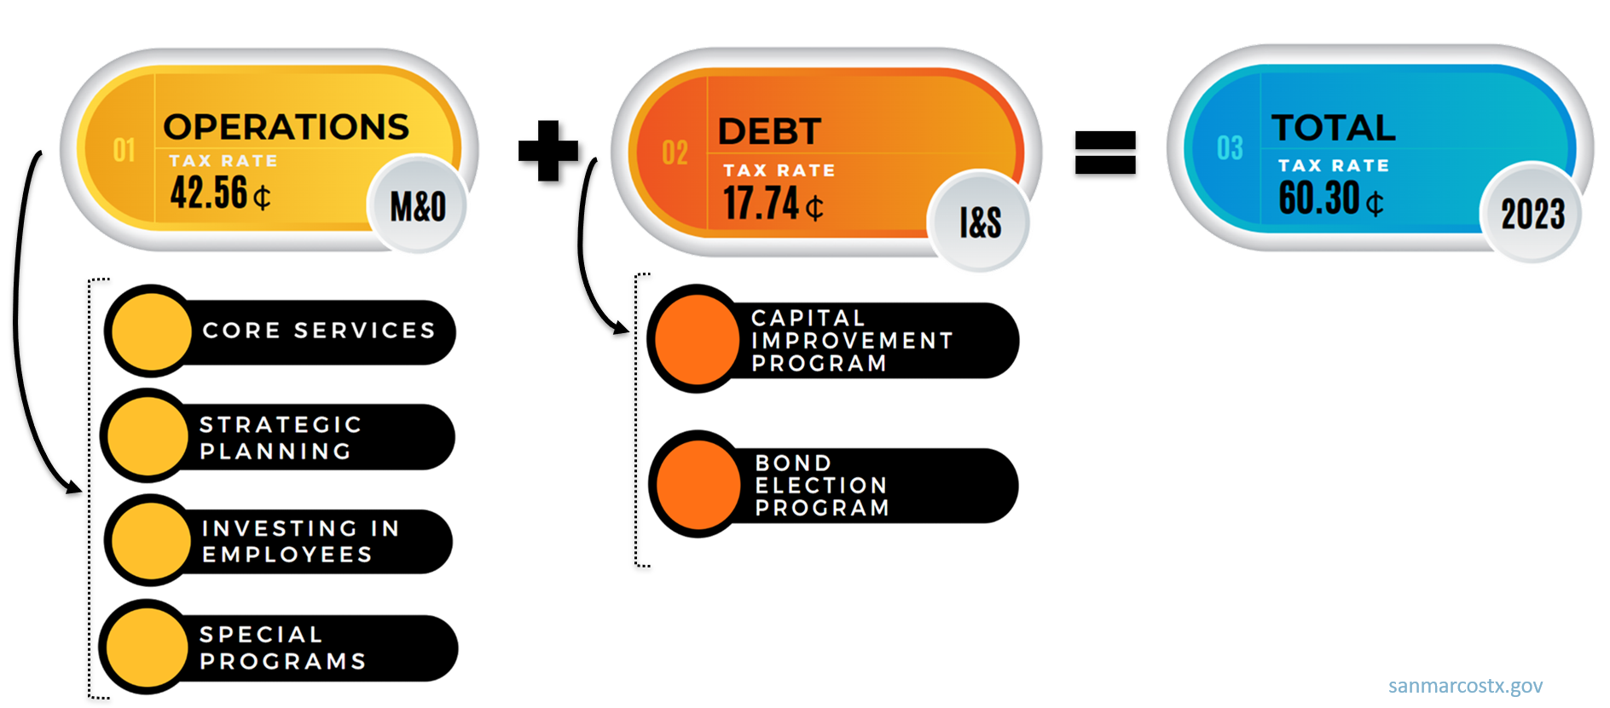
Tax Rate Examples

Slide 14
San Marcos Tax Rate Scenario
San Marcos has a net taxable value of $8.1B; a $0.603 tax rate will generate ~$49M in property tax per year.
San Marcos has a 30% debt service to operations ratio which requires $14.7M for debt service and leaves $34.3M for operations.
San Marcos Police ($25M) and Fire ($15M) budgets are $40M combined (FY 23).
A 1 cent tax rate increase on $8.1B will generate $810,000 in additional funding.

Slide 15
San Marcos Tax Rate Scenario
To open a new fire station costs ~$2.5M:
In San Marcos, which has an $8.1B net taxable value you would have to raise the tax rate by .031 cents to $0.634 to afford one additional station without any new taxable value.
Or
Values need to increase by $440,000,000 in one year to fund an additional station
NOTE: That’s 2,190, $201,000 homes (median home value in San Marcos).

Slide 16
Grapevine Tax Rate Scenario
Grapevine has a net taxable value of $10.4B; a $0.271 tax rate will generate ~$27.3M in property tax per year.
Grapevine has a 47% debt service-to-operations ratio which requires $13.2M for debt service and leaves $14.1M for operations.
Grapevine Police ($3.3M) and Fire ($15.5M) budgets are $18.8M combined (FY 23). GPD has 21.3M budgeted for Operations in the Crime Control District.
A 1 cent tax rate increase on $10.4B will generate $1,040,000 in additional funding.

Slide 17
Tax Rate Scenario
To open a new fire station costs ~$3.1M:
In Grapevine, which has a $10.4B net taxable value, you would have to raise the tax rate by .030 cents to $0.301 to afford one additional station without any new taxable value.
Or
Values need to increase by $1,300,000,000 in one year to fund an additional station
NOTE: A one-cent tax rate increase on 10.4B will generate $1,040,000 in additional funding, which will add a fourth MICU with nine personnel.

Slide 18
Harris County ESD No. 9 Tax Rate Scenario
HCESD9 has a net taxable value of $61.5B; a $0.04436 tax rate will generate ~$27M in property tax per year.
HCESD9 collects $.01 sales/use tax and will generate ~$55M.
HCESD9 has no debt service.
HCESD9 Operating budget is $80M (FY 23).
A 1 cent property tax rate increase on $61.5B will generate ~$6M in additional funding.

Slide 19
Tax Rate Scenario
To open a new fire station costs ~$2.3M:
In Cy-Fair, which has a $61.5B net taxable value you would have to raise the tax rate by .00374 cents to $0.0481 to afford one additional station without any new taxable value.
Or
Values need to increase by $5,200,000,000 in one year to fund an additional station
NOTE: That’s 14,857, $350,000 homes (median home value in Cypress).

Slide 20
Parker County ESD No. 1 Tax Rate Scenario
Parker ESD 1 has a net taxable value of $10.8B; a $0.098 tax rate generates $10.6M in property tax per year, and a 1.5% sales tax rate that generates $3.8M per year, for a total of $14.4M in revenue.
Parker ESD 1 has a 7.3% debt service-to-operations ratio which requires $1.05M for debt service and leaves $13.3M for operations, admin, capital, & reserve funds.
A 1 cent tax rate increase on $10.8B will generate $1,080,000 in additional funding.

Slide 21
Tax Rate Scenario
To open a new fire station costs ~$3.9M (Station, FF&E, Apparatus)
In Parker ESD 1, which has a $10.8B net taxable value, you would have to raise the tax rate by $0.036 cents to build and equip one additional station without any new taxable value. (Does not include staffing & ops overhead)
Or
Values need to increase by $3,900,000,000 in one year to fund an additional station
NOTE: That’s 9,307, $419,633 homes & about 27,000 more people. (2023 Parker County Median Home Value)

Slide 22
How is the $$ Divided

Slide 23
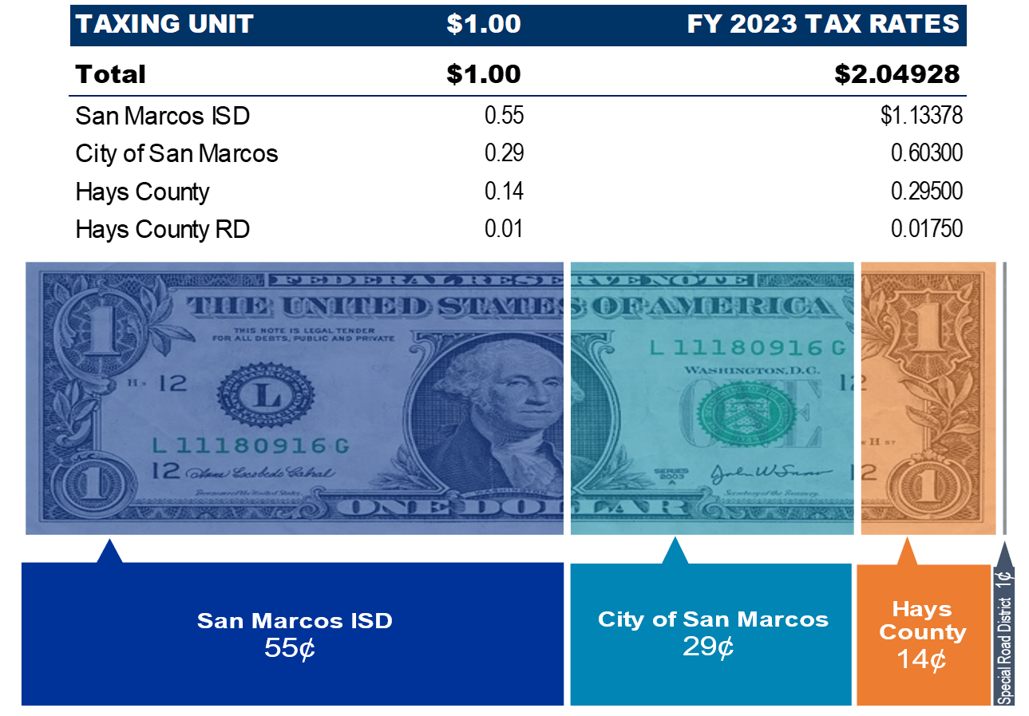
How is the $$ Divided

Slide 24
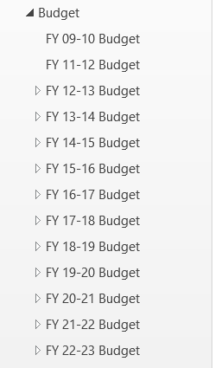
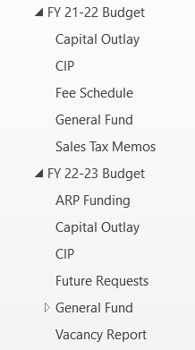
Helpful Hints

Slide 25
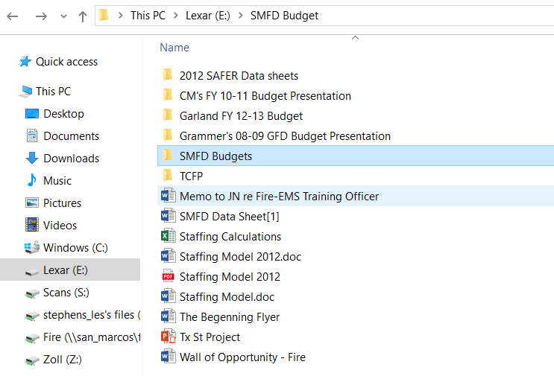
Helpful Hints

Slide 26
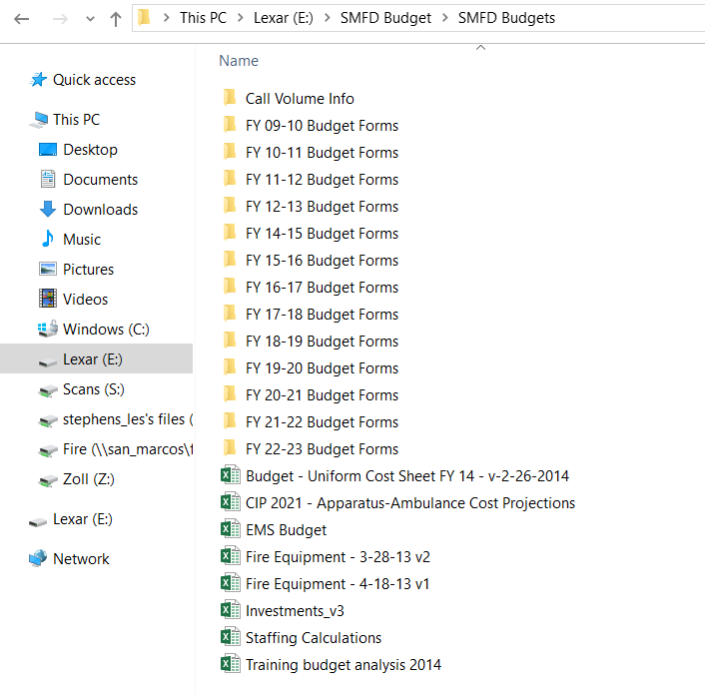
Helpful Hints

Slide 27
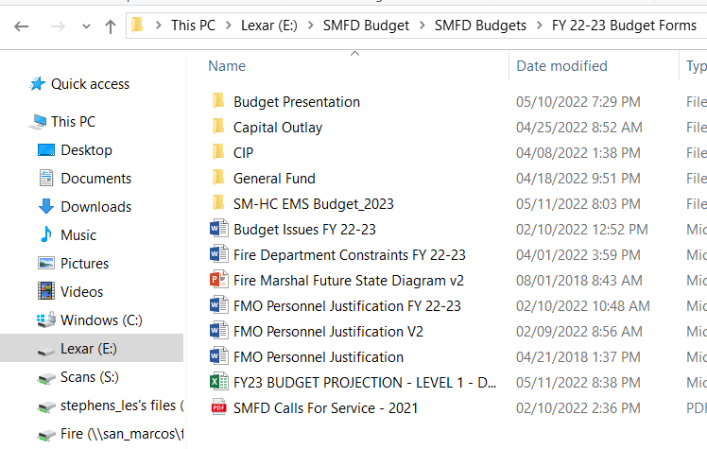
Helpful Hints

Slide 28
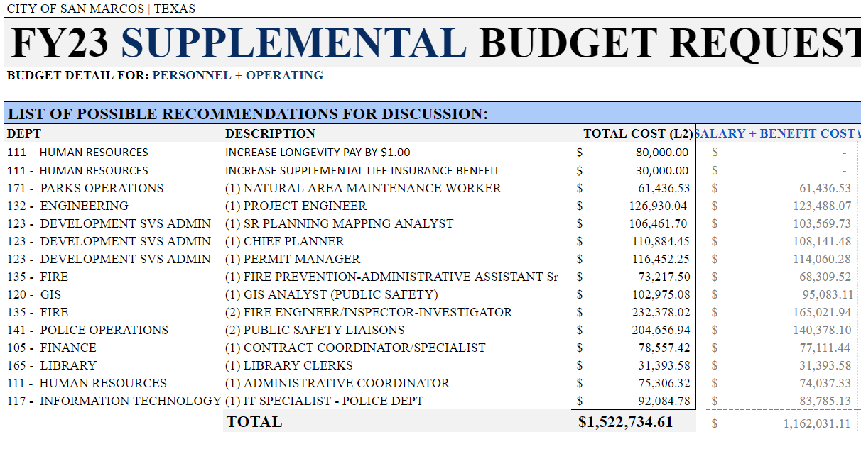
Managing Expectations
Requested 32 positions; (3) above / $1,522,734 x .20% = $305,595
$.01 add $703K = 4 add’l positions for a blocker apparatus = >34%

Slide 29
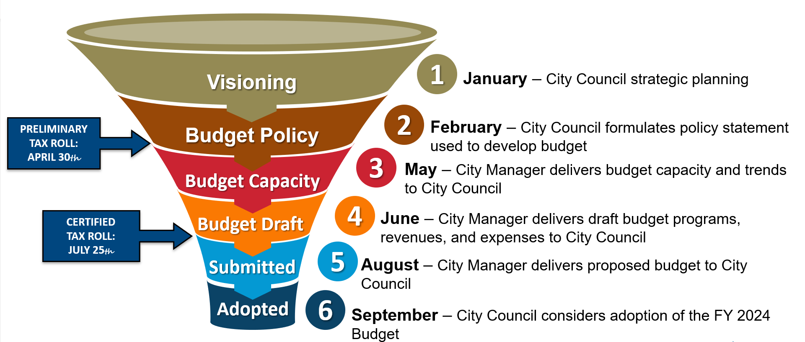
Phases of the Budget Cycle

Slide 30
Why Develop a CIP?
“If You Fail to Plan, You Plan to Fail”
Benjamin Franklin

Slide 31
Capital Improvements Overview
What is a CIP?
Why develop a Capital Plan
Community Input
The Budget Connection

Slide 32
What is a CIP?
Capital Improvement Project: Construction, Major Maintenance and Improvement Projects. Includes Infrastructure Upgrades and Replacement
Capital Improvement Plan: 5-10 Year Plan
Update Annually – Not “One and Done”
Approved by Council
Future Capital Improvement Projects

Slide 33
Why Develop a Capital Plan
Inform Your Citizens of what Projects are Planned
Provides Certainty for the Future
Aides in Outreach and Construction Coordination
Prioritizes Capital Construction & Maintenance
Helps Forecast/ Coordinate Long-term Needs
Ensures Infrastructure is Maintained & Upgraded
Provides a Plan for Funding
Maintain High Bond Ratings
Allows Time to Plan for Large Projects

Slide 34
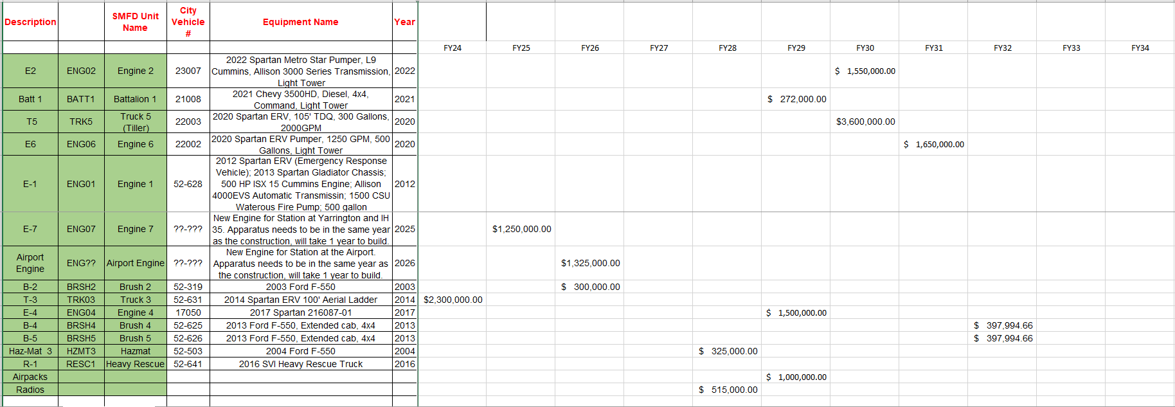
Helpful Hints

Slide 35
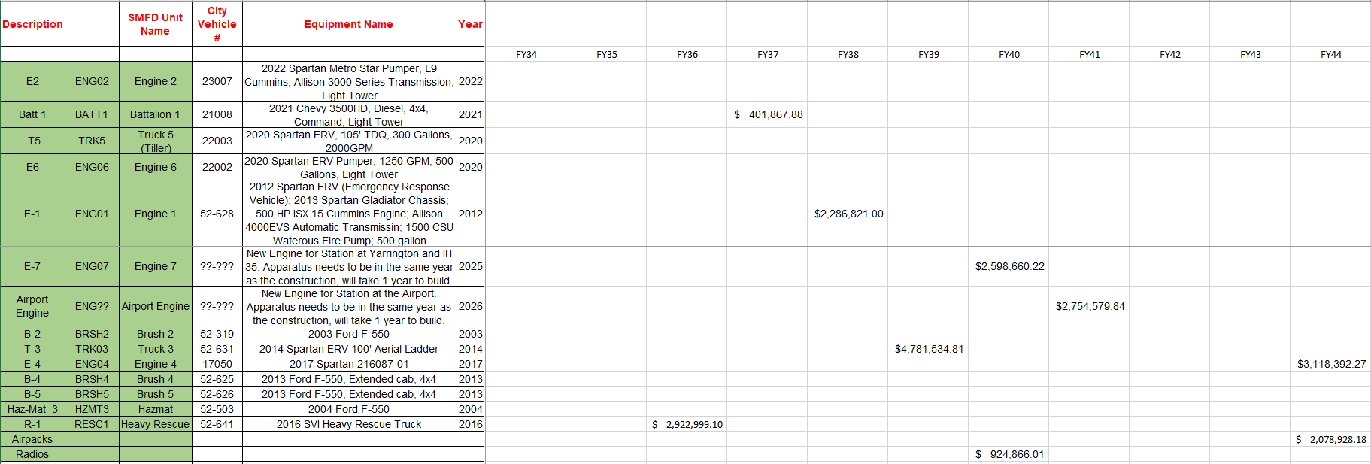
Helpful Hints

Slide 36
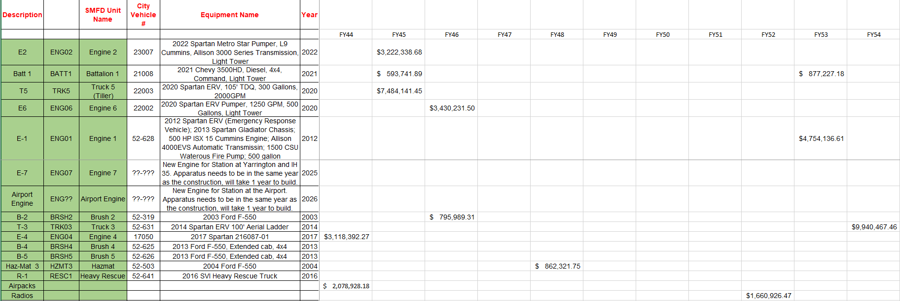
Helpful Hints

Slide 37
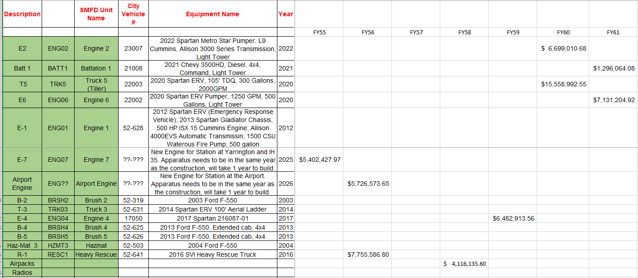
Helpful Hints

Slide 38
Community Input

Slide 39
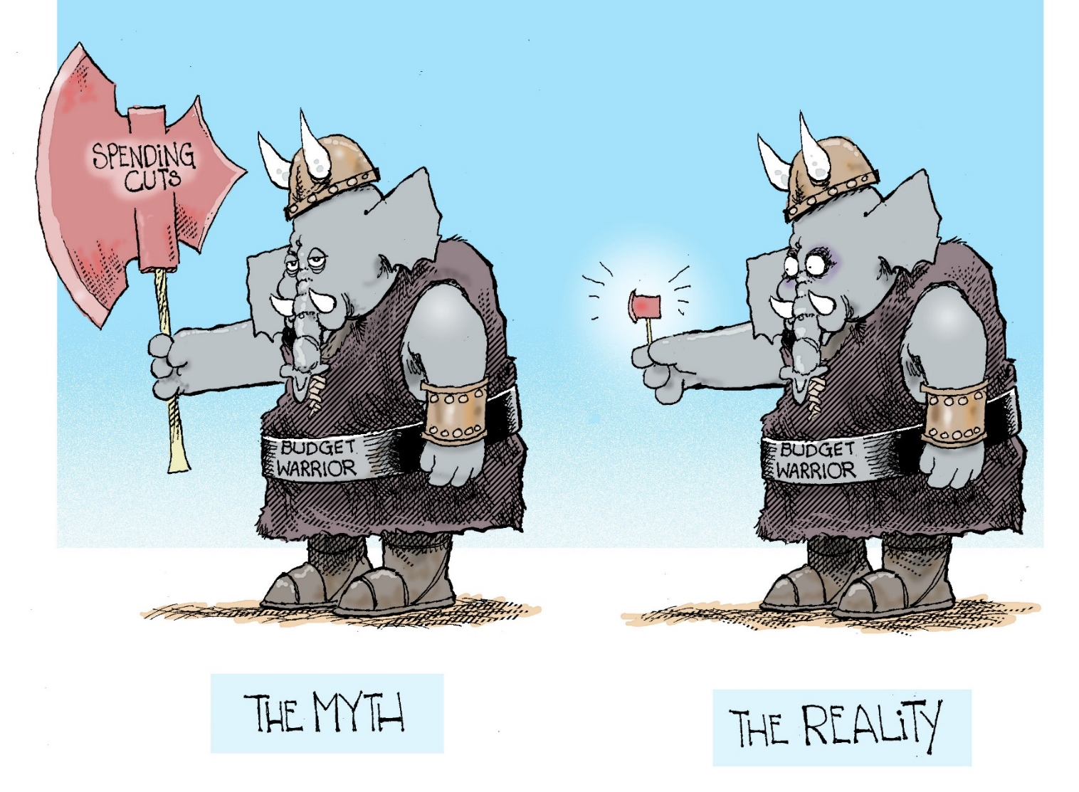
The Budget Connection

Slide 40
The Budget Connection – How Do These Projects Fit
Funds Identified for Initial Construction
Annual Budgets Must Include Operating and Maintenance Costs
Inflation Should be Factored into the Equation
Set Aside Contingency Funds
Internal Service Funds Used to Set Aside Funds for Future Purchases
Long Term Forecasting Included in the Annual Budget Process

Slide 41
Capital Maintenance Program
Deferred Maintenance Increases Future Capital Costs
On-going Capital Maintenance is Included in Operating Budget
Internal Service Funds - “Lease” Equipment to Departments
Lease Fees Fund Capital Repairs and Replacement

Slide 42
What is Truth-In-Taxation
Also known as TNT

Slide 43
2020 Truth-In-Taxation
Property owners have the right to know about increases in their properties’ appraised value and to be notified of the estimated taxes that could result from the new value
A taxing unit must publish its no new revenue tax rate and its voter approval rate before adopting an actual tax rate
A taxing unit must publish special notices and hold one public hearing before adopting a tax rate that exceeds the lower of the voter approval rate or the no new revenue tax rate
If a city adopts a tax rate exceeding the voter approval rate (3.5% M&O growth plus unused increment rate), a city must hold an automatic election in November

Slide 44
No New Revenue Tax Rate
No-New-Revenue Tax Rate: The tax rate that would produce the same amount of property tax revenue when applied against properties taxed in both years.
Voter-Approved Tax Rate: The maximum rate allowed by law without voter approval and is the tax rate that would produce the same amount of property tax revenue for operations when applied against properties taxed in both years, plus 3.5%, plus the tax rate necessary to meet debt service requirements, and plus any unused increment from the prior three years.

Slide 45
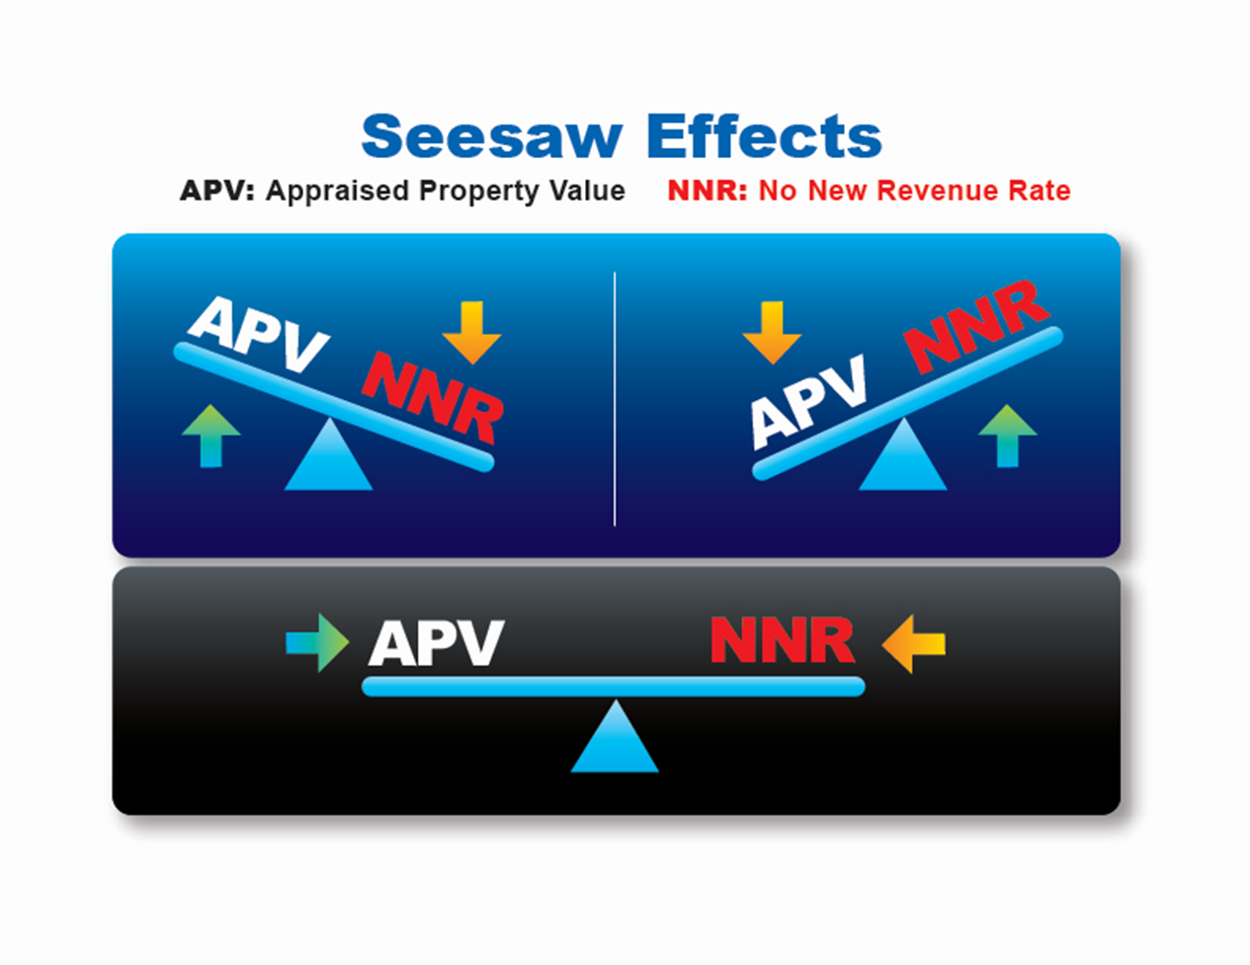
See-Saw Effects

Slide 46
A Brief Review of the Process
Appraisal District Provides Value
Governing Body Drafts Budgets
Tax Assessor Calculates Rates, May Publish Notices
Governing Body Proposes Rate/Holds Hearings
Governing Body Adopts Tax Rate
Tax Assessor Mails Bills

Slide 47
What are the Most Common Policies
Budget
Revenues/Expenditures
Fund Balance/Reserves
Accounting, Auditing and Financial Reporting
Internal Control
Asset Management

Slide 48
Other Common Policies
Capital Improvements and Maintenance
Debt Management
Investment
Grants
Economic Development
Risk Management

Slide 49
Asset Management
Investment Policy
Reviewed Annually by Council
Confirms to Legal Requirements
Governed by PFIA
Required Training
Adopted Policies
Regular Reporting - Quarterly
Fixed Assets
Capitalization Criteria - $5,000
GASB 34 Requirements

Slide 50
Debt Management
Use of Debt Financing
Future Use Against Future Payment
Long-Life Capital Assets
Affordability Targets
Debt Per Capita
Debt as a Percent of Taxable Value
Debt Service Payments as % of Current Revenues
Debt Tax Rates as Percent of Total Tax Rate
Sale Process
Competitive vs. Negotiated
Full and Continuing Disclosure

Slide 51
Types of Debt
General Obligation
Tax Supported and Voter Approved
Certificates of Obligation
Tax Supported
Issued by Council after Notice Process
Revenue Bonds
Repaid through Rates
Self-Supporting Debt
Tax Debt PAID FROM OTHER SOURCES
Internal Borrowings
Between Funds Within the City
Agreements with TXDOT

Slide 52
Other Funding Alternatives
Grants
Use of Reserve Funds
Developer Contributions
Leases
Impact Fees
CARES Act Funding

Slide 53
Accounting and Financial Reporting
Provide Quarterly/Monthly Reports to Council
Outside Audit Annually of all City Accounts
Accountable Directly to City Council
Prepare (CAFR)
Follow GFOA Standards and Best Practices

Slide 54
Internal Controls
Deterrents
Stop it Before it Starts!
Detection Controls
If Can’t Stop it, Detect it Early!
Actively Pursue
Acknowledge Risks that Arise from Staff Cuts
Internal Control Program / Audits
Written Policies Reviewed Annually

Slide 55
Financial Reserves
Fund Balance Policy – 25-30%
Rainy Day Fund for Unexpected Emergency
90 Day Reserve in General Fund
30 Days = “Emergency” Funds
Offset Sudden Tax Decrease
Replenished Next Budget Cycle
60 Days = Long-term Reserves

Slide 56
Conclusion
Allow policies to guide City’s financial operations
1
Adhere to the guidelines addressed in the policies
2
Benchmark to ensure policies are reasonable and achieve desired goals
3
Communicate policies and guidelines to citizens and employees
4

Slide 57
Questions?

Slide 58
Budget Contingency Plan
A Contingency Plan describes actions that can or should be executed when a specific contingency occurs
A Budget Contingency Plan is designed to establish general policy guidelines for handling gaps between revenues and expenditures
Determines the appropriate course of action management can take in anticipation of or in response to significant changes in the City’s balance of revenues and expenditures

Slide 59
Results of Good Budgeting Practices
Good budgeting results in a number of positive financial outcomes:
Balanced Budgets
Positive Budget Variances
Positive Fund Balances
Improved Bond Ratings
Avoidance of Enterprise Fund Subsidies/Transfers
Stable Finances

